Slide 1
Scholarly Impact Metrics:
Beyond Citations to Measure True Influence
Laura Dormer
Co-Founder & Editorial Director
Becaris Publishing Ltd, UK
laura@becaris.com

Slide 2
What is scholarly impact?
“…the demonstrable contribution that excellent research makes to society and the economy.”
Economic and Social Research Council
“…a change or a benefit to the economy, society, culture, public policy or services, health, the environment or quality of life.”
European Commission

Slide 3
Traditional metrics in publishing
Journal
• Impact Factor
• CiteScore
• SJR
• SNIP
• Eigenfactor
Researcher
• H-index

Slide 4
Traditional metrics in publishing
Journal Impact Factor
H-Index

Slide 5
Expanding beyond citations
Article views
Downloads
Social media shares
Media mentions
Policy documents
Medical guidelines
Patents
Data re-use
Inclusion in educational syllabi

Slide 6
Recent developments in scholarly impact metrics

Slide 7
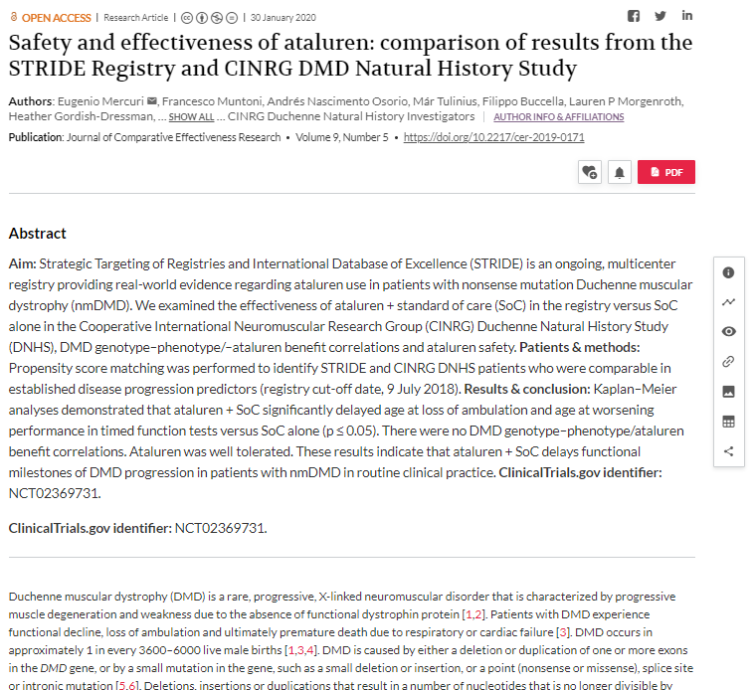
Dimensions & Altmetric

Slide 8
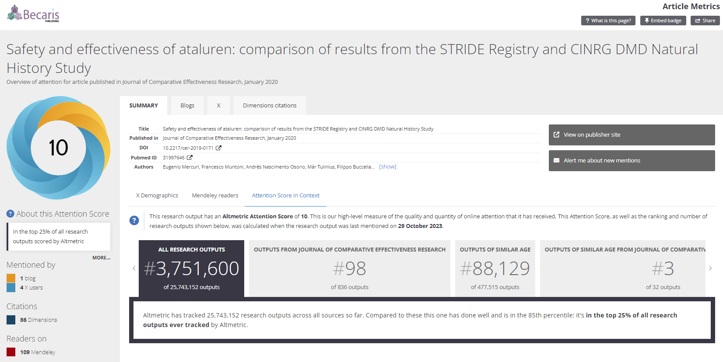
Dimensions & Altmetric

Slide 9
Recent developments in scholarly impact metrics
Open data re-use and impact
Mention of outputs on course syllabi
Mention in policy documents

Slide 10
Qualitative impact
Quantitative measures
Qualitative measures
Journal Impact Factor
H-Index
Altmetrics
Peer review
Public/Patient engagement
Impact case studies

Slide 11
Responsible use of metrics for publishers
Information for authors
• Pre-submission to post-publication
Monitoring journal performance
• Different metrics for different questions

Slide 12
Declaration on Research Assessment (DORA)
A world-wide initiative designed to improve the ways in which the outputs of scholarly research are evaluated
Individuals and organisations can sign up to support the DORA declaration, including publishers
https://sfdora.org/

Slide 13
Leiden Manifesto for research metrics
A set of ten principles published in 2015
Aimed at guiding the use of research metrics in the evaluation of scientific research
Responding to concerns about the misuse of metrics
Encourages fair and transparent assessment practices
Widely endorsed by institutions, funders, and publishers worldwide
https://www.nature.com/articles/520429a

Slide 14
Contributor Role Taxonomy (CRediT)
Detailed author contributions: specifies 14 distinct roles to accurately reflect each author's specific contributions to a research project
Enhanced transparency and accountability: promotes transparency and proper attribution, ensuring that all contributors receive appropriate recognition for their work
https://credit.niso.org/

Slide 15
Open Researcher and Contributor ID (ORCiD)
Unique researcher identifier: a persistent identifier (PID) that distinguishes researchers and connects them with their work, affiliations, and contributions.
Integration and interoperability: integrates with various research workflows and systems, ensuring accurate attribution and enhancing the visibility of researchers' outputs and achievements
https://orcid.org/

Slide 16
Best practice for the use of scholarly impact metrics
Use a mix of quantitative and qualitative measures
Contextualize citations
Promote transparency and integrity in metric reporting
Evaluate broader impacts on society, policy and practice
Support responsible use and interpretation of metrics

Slide 17
What role might AI play?
Opportunities
Enhanced data collection and analysis
Risks
Over-reliance on (quantitative) metrics
Development of new metrics
Personalized impact assessments
Real-time metrics
Integration of diverse data sources
Predictive analytics
Cross-disciplinary impact assessment
Data quality improvement
Bias and fairness
Privacy and data protection
Transparency and interpretability

Slide 18
Conclusions
Scholarly impact metrics can give an indication of an article/journal/researcher’s impact
However, traditional, citation-based metrics have limitations:
Can be skewed by a few highly cited papers
Can disadvantage smaller, niche journals
Less emphasis on research quality or societal impact
Potential for manipulation
Altmetrics have attempted to address some of these issues
Best practice:
Use a mix of metrics
Contextualize citations
Encourage transparency in metric reporting
Evaluate broader impacts on society/policy/practice
Support responsible use and interpretation of metrics

